Slide 1
Regression with Time Series Data:
Stationary Variables
Part 3
BUAN / MECO 6312
Dr. Moran Blueshtein
University of Texas - Dallas

Slide 2
How to Identify Serial Correlation?

Slide 3
Correlogram

Slide 4
Serial Correlation
Computing Autocorrelation
The population correlation between two errors that are 1 periods apart in time:
This is known also as the population autocorrelation of order one.
var(e_{t}) = var(e_{t-s}) holds if time series are stationary

Slide 5
Serial Correlation
Computing Autocorrelation
More generally, the k-th order population autocorrelation between two errors that are k periods apart in time:
We can build a sequence of population autocorrelations

Slide 6
Serial Correlation
Computing Autocorrelation
Our estimate to the population autocorrelation of order 1 is the first order sample autocorrelation:

Slide 7
Serial Correlation
Computing Autocorrelation
More generally, the k-th order sample autocorrelation is our estimate to the population autocorrelation of order k

Slide 8
Serial Correlation
A Phillips Curve
Consider a model for inflation as a function of change in unemployment (Known as the Phillips Curve):
What should be the sign of ?
We suspect that the error e_{t} is autocorrelated.

Slide 9
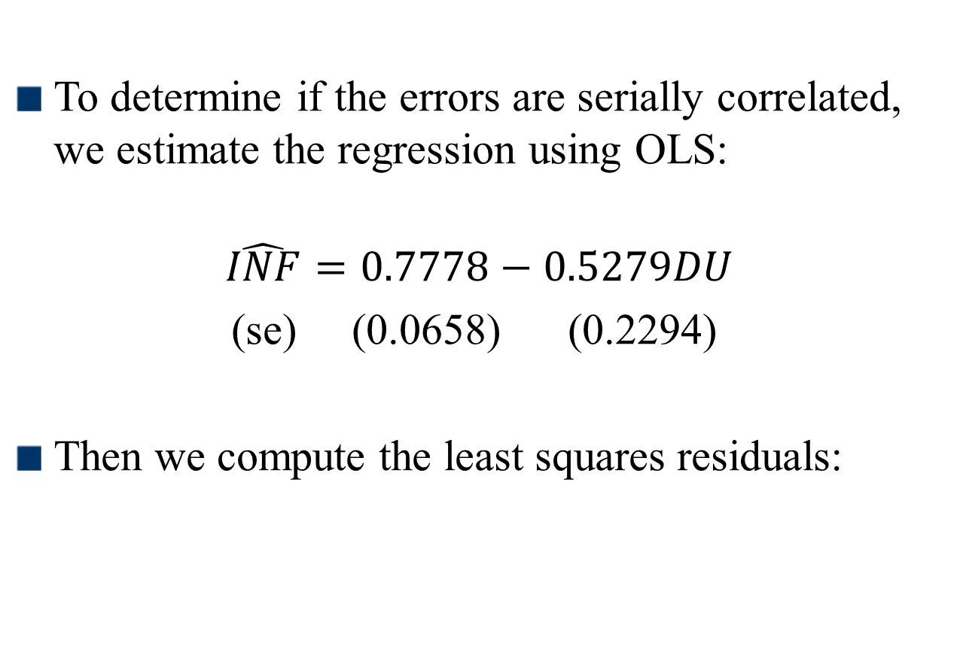
Serial Correlation
A Phillips Curve
To determine if the errors are serially correlated, we estimate the regression using OLS:
$$\hat{INF}=0.7778−0.5279DU$$
(se) (0.0658) (0.2294)
Then we compute the least squares residuals:

Slide 10
Serial Correlation
The Correlagram
The correlogram, also called the sample autocorrelation function, is the sequence of autocorrelations r₁, r₂, r₃, …
It shows the correlation between residuals that are one period apart, two periods apart, three periods apart, and so on…

Slide 11
Serial Correlation
Computing Autocorrelation
How do we test whether an autocorrelation is significantly different from zero?
The null hypothesis is H₀: ρ_{k} = 0
Using the correlogram we find that correlations at lags one through five are all significantly different from zero at 5% significance level.

Slide 12
Estimation with Serially Correlated Errors

Slide 13
Estimation with Serially Correlated Errors
Least Squares
Estimation
Suppose we proceed with least squares estimation without recognizing the existence of serially correlated errors. What are the consequences?
The least squares estimator is still a linear unbiased and consistent estimator, but it is no longer best
The formulas for the standard errors usually computed for the least squares estimator are no longer correct
Confidence intervals and hypothesis tests that use these standard errors will be misleading

Slide 14
Autoregressive Distributed Lag Models

Slide 15
Estimation with Serially Correlated Errors
Suppose we want to estimate:
with -1 < ρ < 1
For the v_{t}, we have:

Slide 16
Estimation with Serially Correlated Errors
With the appropriate substitutions, we get:
For the previous period, the error is:
Multiplying by ρ:

Slide 17
Estimation with Serially Correlated Errors
ARDL models
Substituting we get:
Denote:
We get:
By adding lags of x and y to the model, we have eliminated the serial correlation. We can estimate the transformed model using OLS, and the estimates are BLUE!

Slide 18
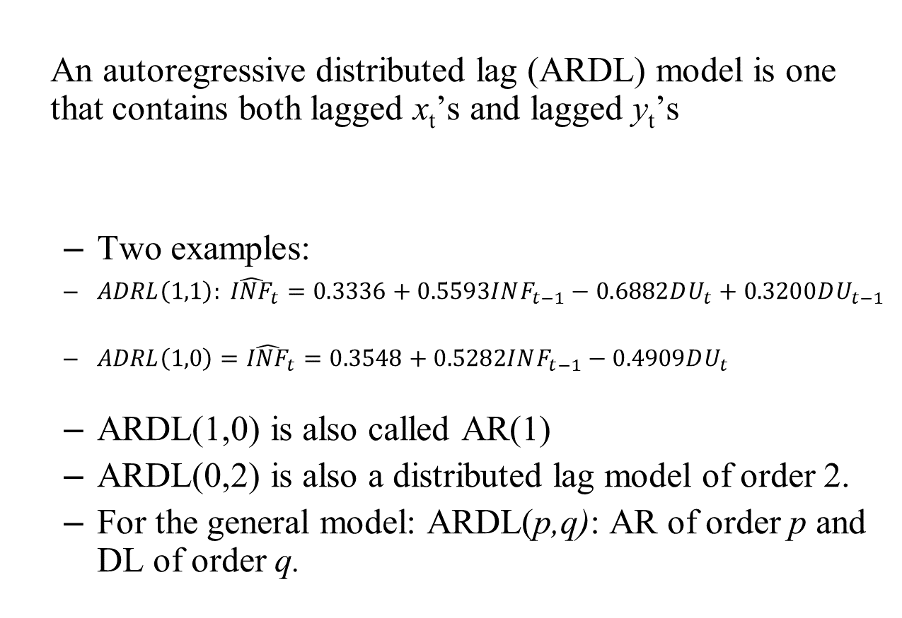
Autoregressive Distributed Lag Models
An autoregressive distributed lag (ARDL) model is one that contains both lagged x_{t}’s and lagged y_{t}’s
Two examples:
$ADRL\left(1,1\right): {\hat{INF}}_{t}=0.3336+0.5593INF_{t−1}−0.6882DU_{t}+0.3200DU_{t−1}$
$ADRL\left(1,0\right)={\hat{INF}}_{t}=0.3548+0.5282INF_{t−1}−0.4909DU_{t}$
ARDL(1,0) is also called AR(1)
ARDL(0,2) is also a distributed lag model of order 2.
For the general model: ARDL(p,q): AR of order p and DL of order q.

Slide 19
Choosing The Correct ARDL Model

Slide 20
Autoregressive Distributed Lag Models
Four possible criteria for choosing p (order of AR) and q (order of distributed lag):
Has serial correlation in the errors been eliminated?
Are the signs and magnitudes of the estimates consistent with our expectations from economic theory?
Are the estimates significantly different from zero, particularly those at the longest lags?
What values for p and q minimize information criteria such as the AIC and SC?

Slide 21
Okun’s Law - Revisit
Autoregressive Distributed Lag Models
Okun’s Law
Earlier we suggested ARDL(0,2) for Okun’s Law.
Can we improve that model?

Slide 22
Autoregressive Distributed Lag Models
Okun’s Law
Correlogram test suggests serial correlation of order 1 with ARDL(0,2) model.
We add to eliminate serial correlation
We confirm no serial correlation. However…
With ARDL(1,2), becomes insignificant.
We therefore estimate an ARDL(1,1) model
Estimates are all significant and no serial correlation.
ARDL(1,1) is confirmed by both AIC and SC criteria.

Slide 23
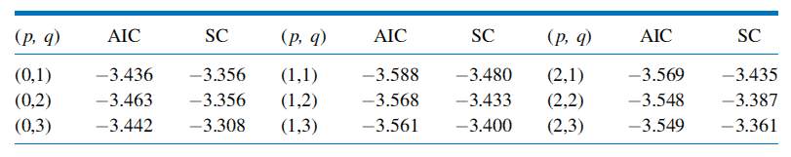
Autoregressive Distributed Lag Models
AIC and SC Values for Okun’s Law ARDL Models
Okun’s Law

Slide 24
Newey-West Standard Errors

Slide 25
Estimation with Serially Correlated Errors
HAC standard errors
It is possible to compute correct standard errors for the least squares estimator:
HAC (heteroskedasticity and autocorrelation consistent) standard errors, or Newey-West standard errors.

Slide 26
Estimation with Serially Correlated Errors
HAC standard errors
However, this approach has serious limitations:
With serial correlation, LS estimator is inefficient: HAC SE are relatively large.
We lose the dynamic interpretation of our estimates!

